Slide 1
Can you…?
Mr Greg’s English Cloud

Slide 2
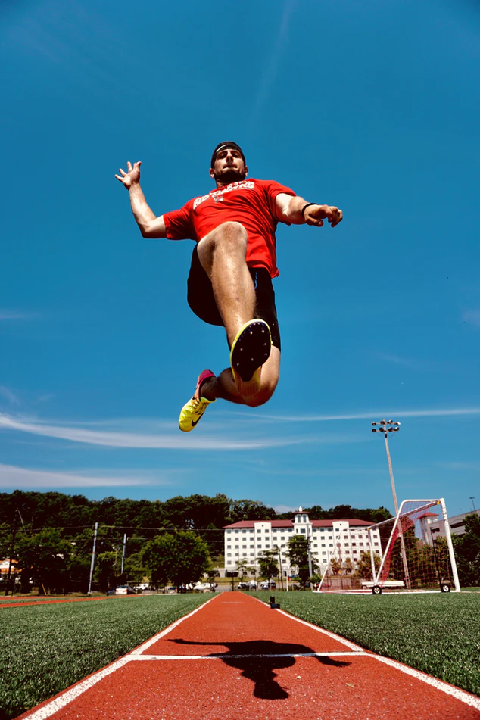
Can you…?
Yes! I can jump.
I can jump high!
No! I can’t jump.

Slide 3
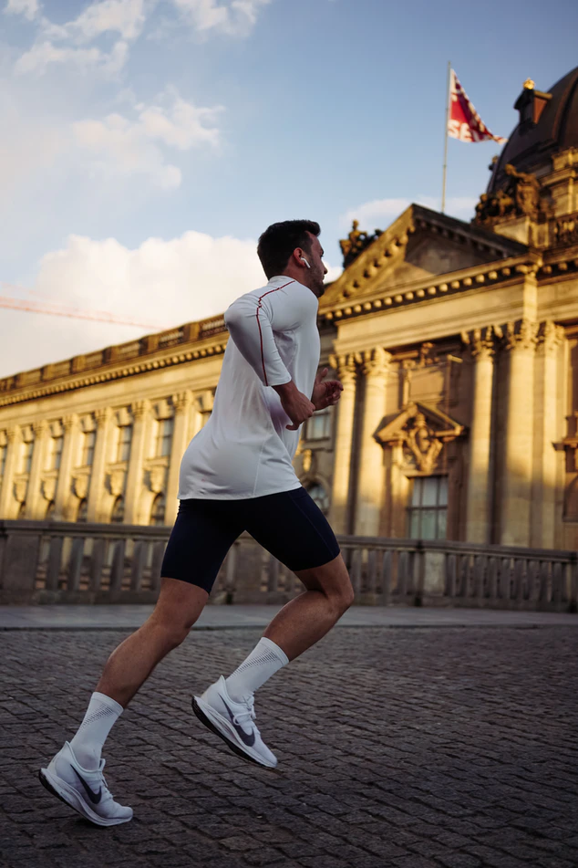
Can you…?
Yes! I can run.
I can run fast!
No! I can’t run.

Slide 4
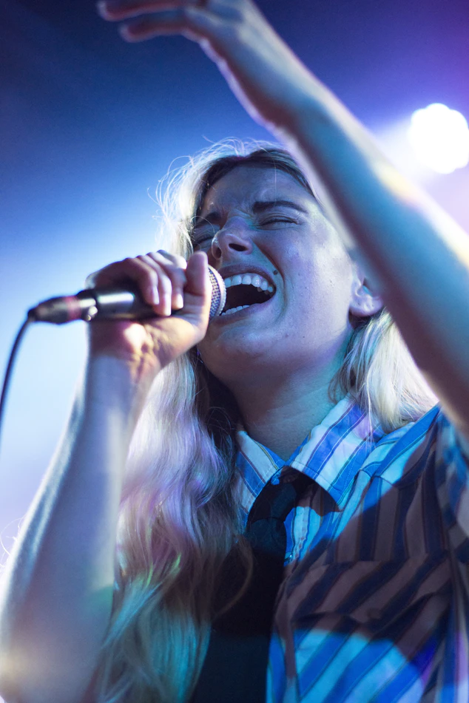
Can you…?
Yes! I can sing.
I can sing very well!
No! I can’t sing.

Slide 5
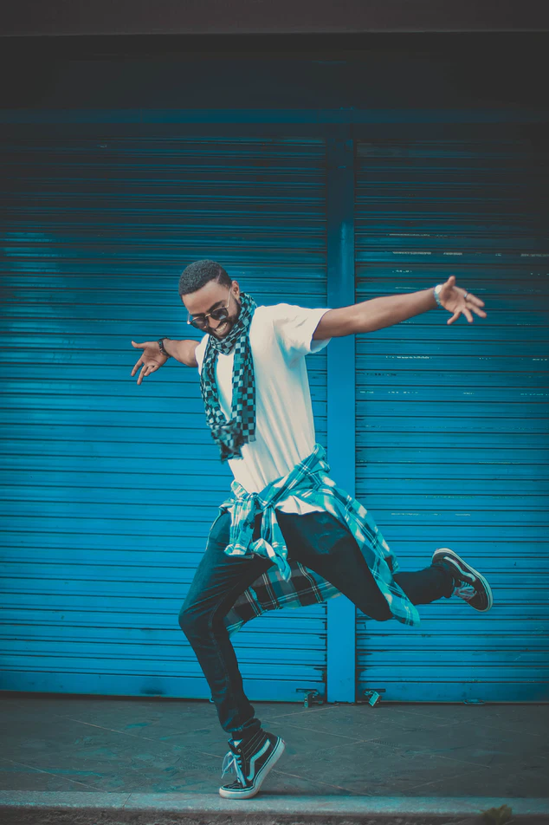
Can you…?
Yes! I can dance.
I can dance very well!
No! I can’t dance.

Slide 6
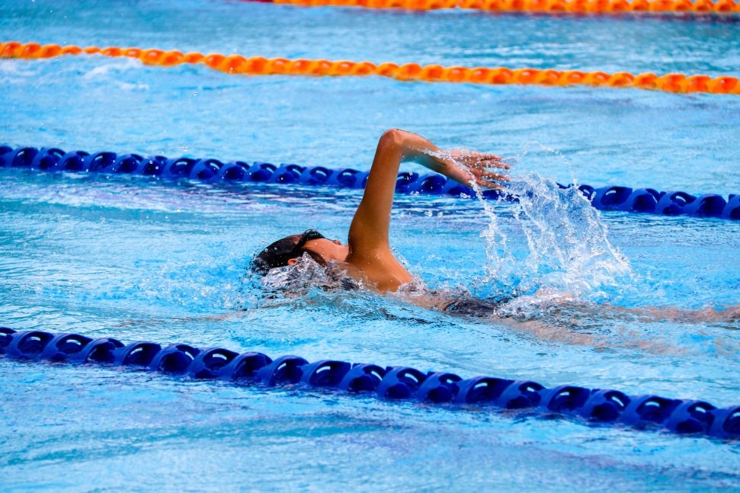
Can you…?
Yes! I can swim.
I can swim fast!
No! I can’t swim.

Slide 7
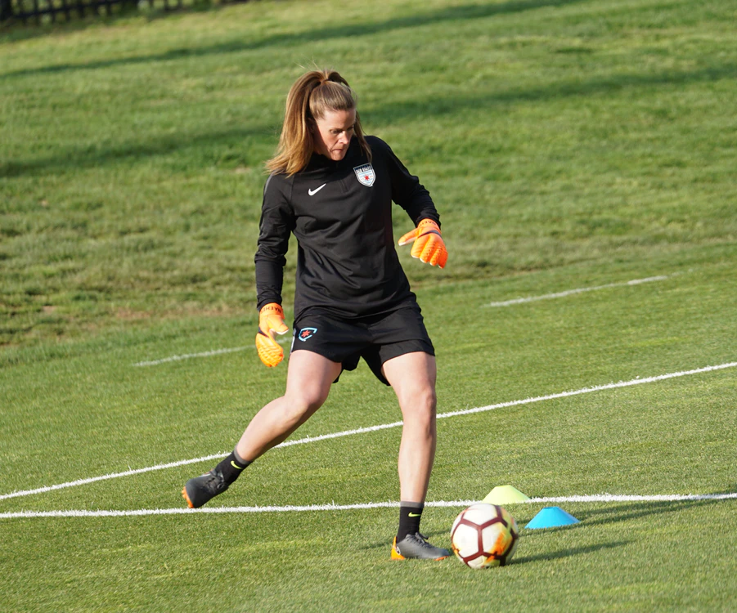
Can you…?
Yes! I can kick.
I can kick the ball!
No! I can’t kick.

Slide 8
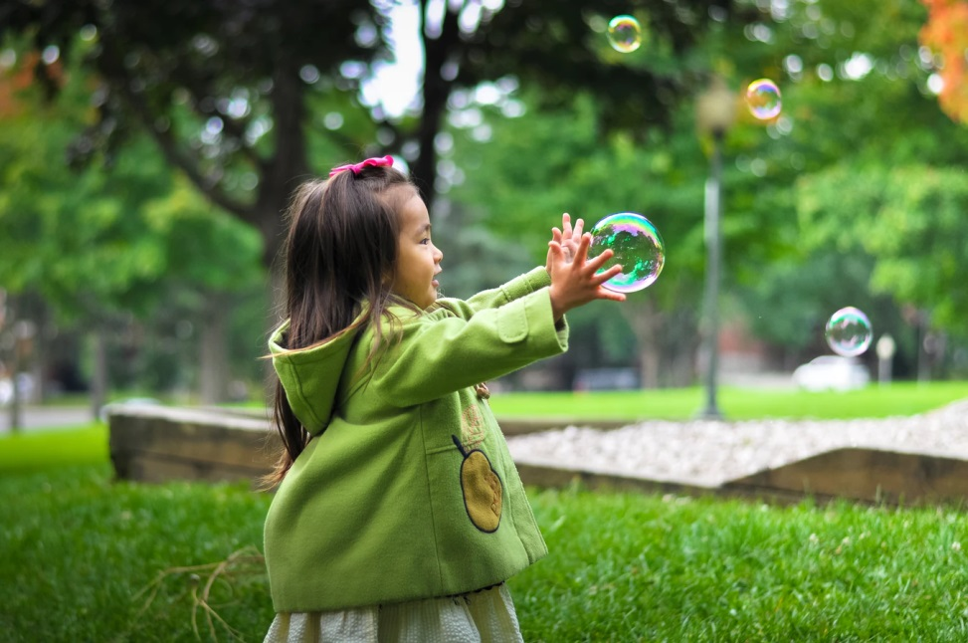
Can you…?
Yes! I can catch.
I can catch the bubble!
No! I can’t catch.

Slide 9
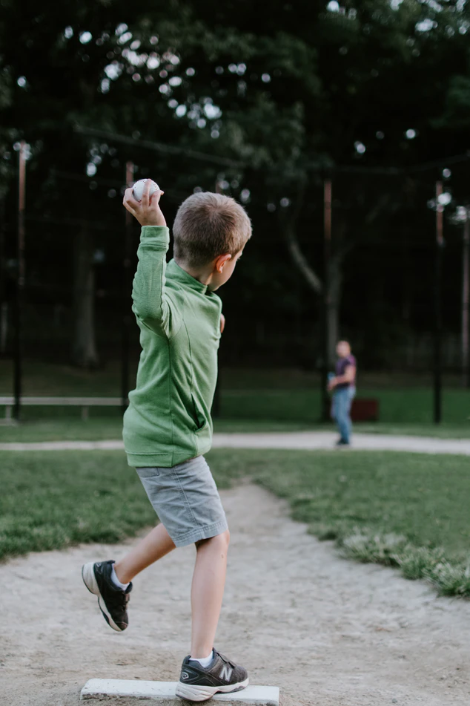
Can you…?
Yes! I can throw.
I can throw the ball!
No! I can’t throw.

Slide 10
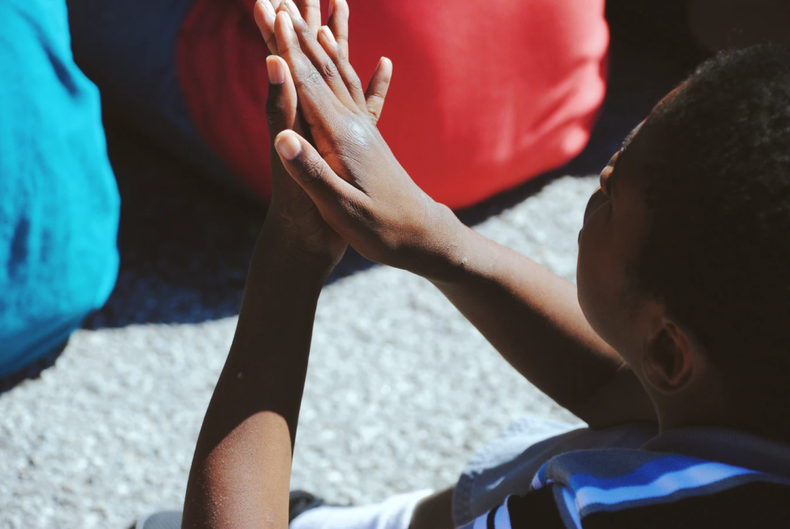
Can you…?
Yes! I can clap.
I can clap my hands!
No! I can’t clap.

Slide 11
Can you…?
Yes! I can clap.
I can clap my hands!
No! I can’t clap.

